Slide 1


EcoPackAI – AI-Powered Sustainable Packaging Recommendation System
Karna Apurupa

Slide 2
PROBLEM STATEMENT
Traditional packaging in industries and e-commerce depends on non-biodegradable materials.
This leads to increased environmental pollution and long-term ecological damage.
High packaging costs arise due to inefficient material selection.
Businesses lack intelligent decision-support systems to choose sustainable alternatives.

Slide 3
CHALLENGES FACED BY MANUAL PACKING MATERIALS
1
2
3
Environmental Impact
Traditional materials like plastics are non-biodegradable, harming the environment.
Cost Constraints
Eco-friendly materials often have higher costs than conventional options.
Fragility & Product Safety
Some sustainable materials lack strength, risking product damage.
4
5
6
CO₂ & Lifecycle Assessment
Calculating CO₂ footprint and lifecycle impact is complex and data-intensive.
Consumer Awareness & Preferences
Consumer preferences may not always favor sustainable packaging.
Material Availability & Standardization
Limited availability and lack of standardized specifications hinder adoption.

Slide 4
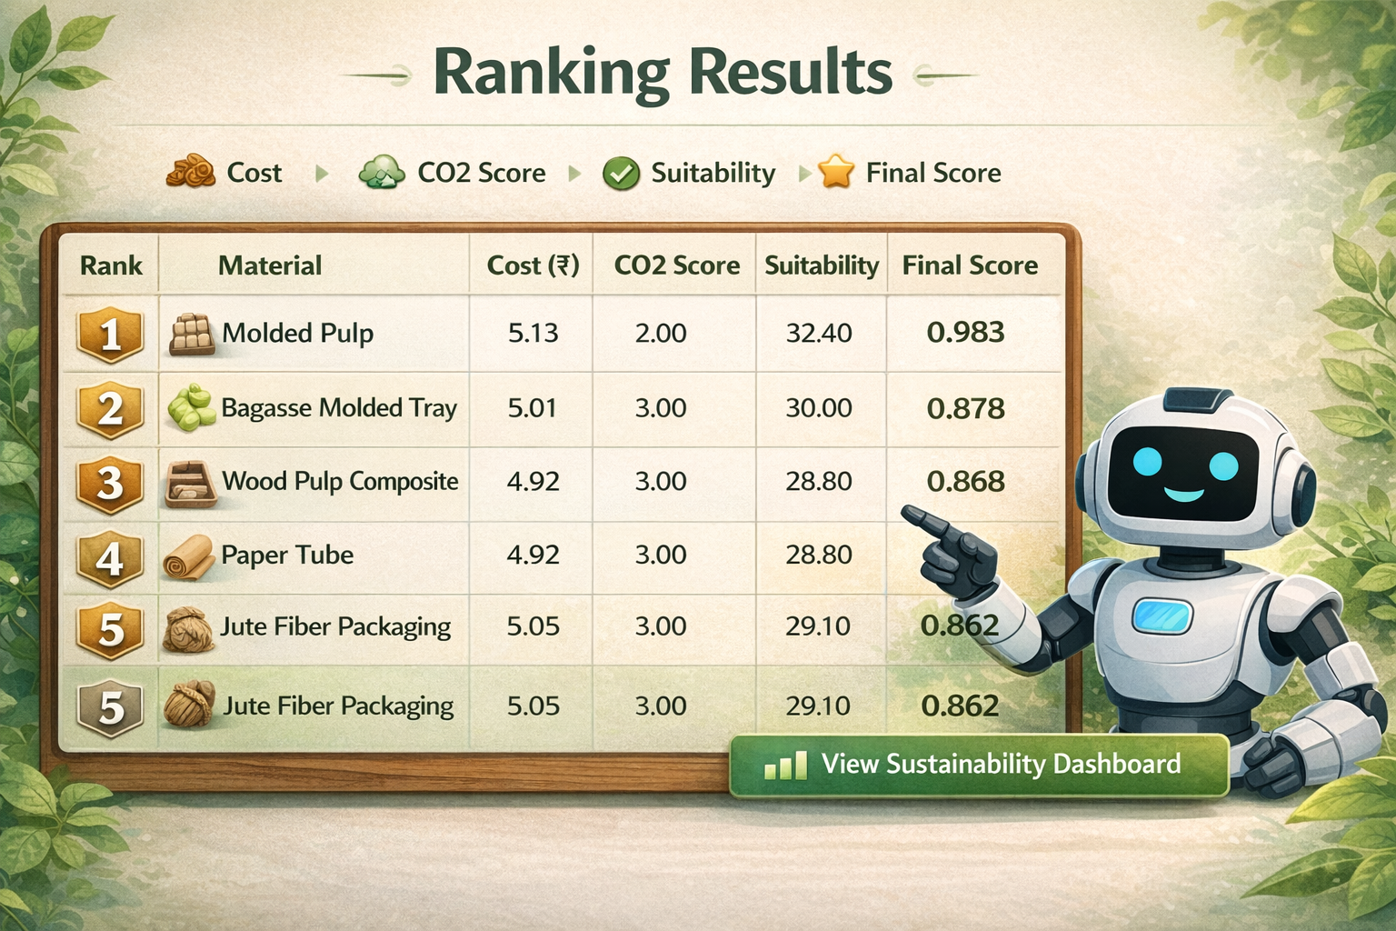
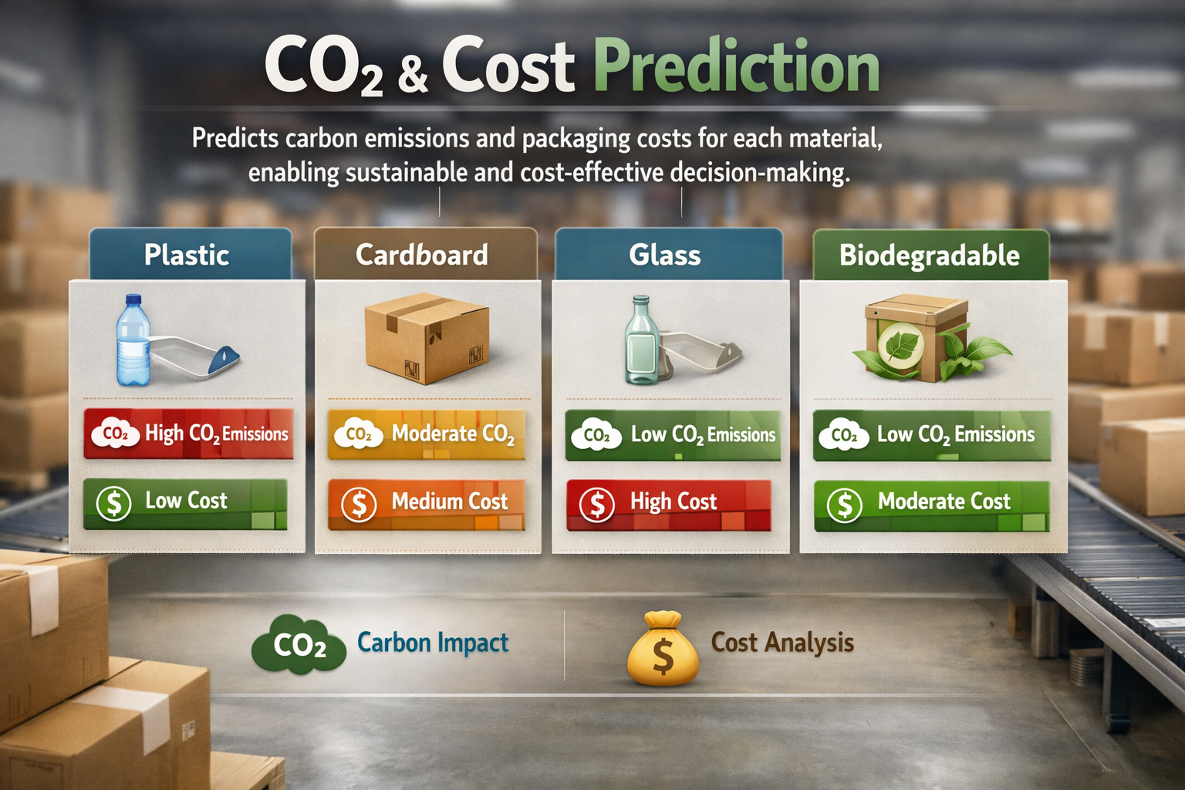
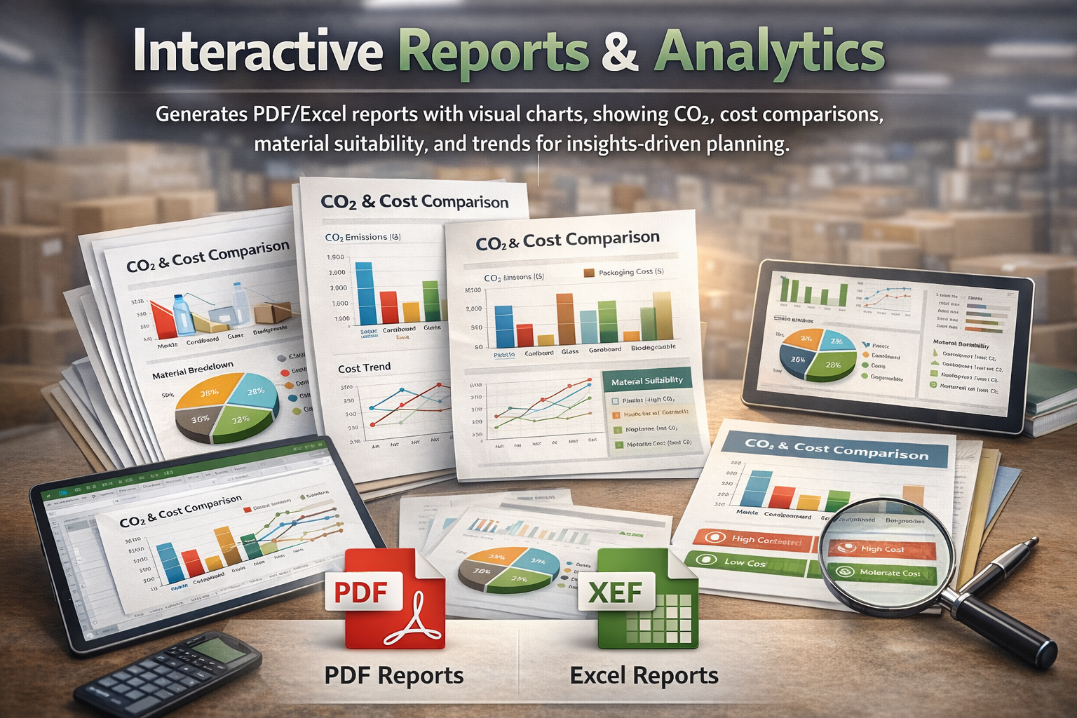
CORE FEATURES OF ECOPACKAI-AI POWERED SUSTAINABLE PACKAGING RECOMMENDATION SYSTEM
CO₂ & Cost Prediction Predicts carbon emissions and packaging costs for each material, enabling sustainable and cost-effective decision-making.
Interactive Reports & Analytics Generates PDF/Excel reports with visual charts, showing CO₂, cost comparisons, material suitability, and trends for insights-driven planning.
AI-Based Packaging Recommendations Businesses receive the top 3 eco-friendly packaging material suggestions tailored to product type, category, fragility, and shipping requirements.

Slide 5
PROPOSED SOLUTION
EcoPackAI is an AI-powered full-stack platform that recommends optimal packaging materials based on product attributes.
Collect eco-friendly packaging material data, clean it, and store it in a PostgreSQL database to calculate sustainability metrics like CO₂ impact and cost efficiency.
Train machine learning models (Random Forest and XGBoost) to predict packaging cost and CO₂ emissions for better material selection.
Develop a Flask backend to process user inputs and generate AI-based packaging recommendations.
Create a user-friendly frontend to display top recommended materials with cost and CO₂ comparison.
Build an analytics dashboard, generate PDF/Excel reports, and deploy the EcoPackAI system on cloud platforms like Render or Heroku.

Slide 6
TECHNOLOGIES USED
POSTGRESQL
MACHINE LEARNING ALGORITHMS
HTML, CSS, BOOTSTRAP
PYTHON FLASK
MATPLOTLIB/
PLOTLY
RENDER/
HEROKU
Database used to store packaging material dataset.
Random Forest, XGBoost
Used to design the user interface of the web application.
Backend framework used to handle user inputs and generate AI recommendations.
Used to create analytical graphs and dashboard.
Cloud platforms used to deploy the application.

Slide 7
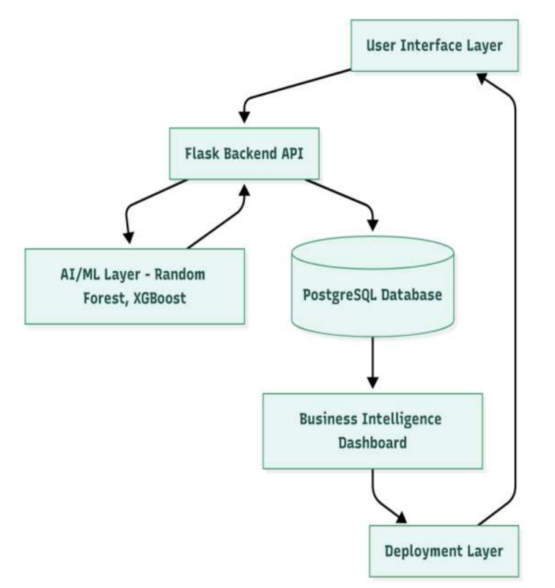
SYSTEM ARCHITECTURE FLOW DIAGRAM
User Interface Layer – Takes product inputs such as product type, category, fragility, and shipping type through the web application.
Application Layer (Flask Backend) – Processes user inputs using REST APIs and connects frontend with ML models and database.
Machine Learning Layer – Uses trained models to predict packaging cost and CO₂ emissions and rank suitable materials.
Database Layer (PostgreSQL) – Stores eco-friendly material dataset information.
Analytics & Output Layer – Displays top 3 recommended materials with cost, CO₂ comparison, dashboard insights, and export reports (PDF/Excel).

Slide 8
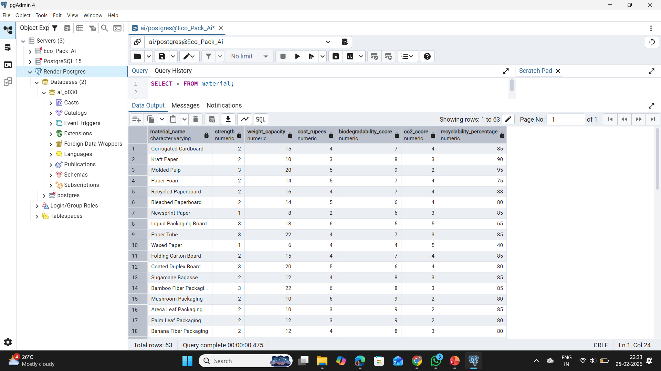
DATA DESCRIPTION
Material strength
Weight handling capacity
Biodegradability level
Recyclability percentage
Packaging cost
CO₂ emission score

Slide 9
Exploratory Data Analysis (EDA)
Cleaned the material dataset by handling missing values and removing inconsistencies
Preprocessed data to improve quality for machine learning models
Normalized numerical features such as strength, cost, and CO₂ score
Analyzed distribution of packaging cost and carbon emissions across materials
Examined material usage trends based on sustainability properties

Slide 10
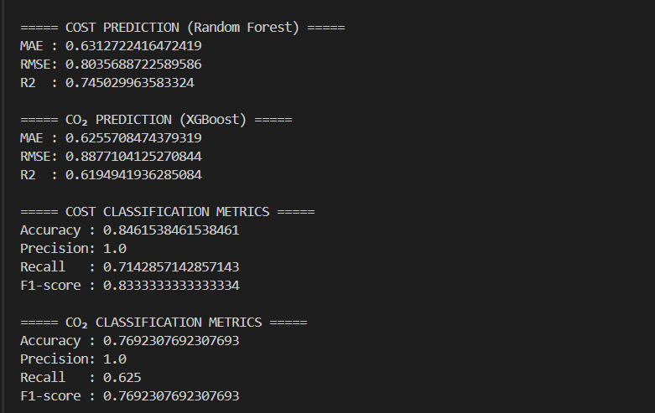
MACHINE LEARNING MODELS & RESULTS
Random Forest: Used for predicting packaging cost as it handles non-linear data and reduces overfitting.
XGBoost: Used for predicting CO₂ emissions due to its high accuracy with complex features.
Data Split: Dataset divided into training and testing sets for reliable model evaluation.
Evaluation Metrics: Performance measured using RMSE, MAE, and R² scores.

Slide 11
MEASURABLE OUTCOMES AND POSITIVE IMPACTS
Measurable Results:
Top 3 optimized material recommendations
Predicted packaging cost
Estimated CO₂ emissions
Eco Score & Suitability Score
Positive Outcomes:
Reduction in packaging cost
Lower carbon footprint
Improved sustainable material selection
Data-driven packaging decisions

Slide 12
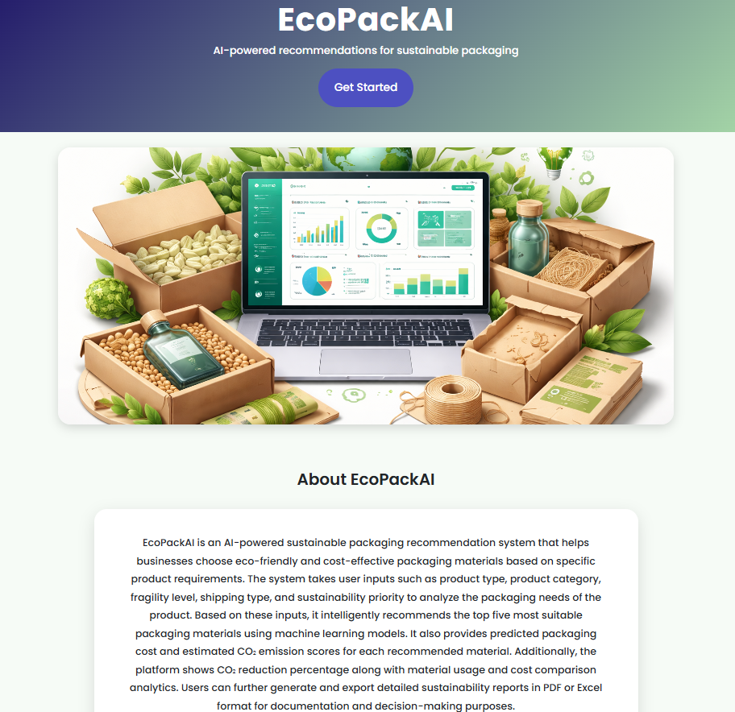
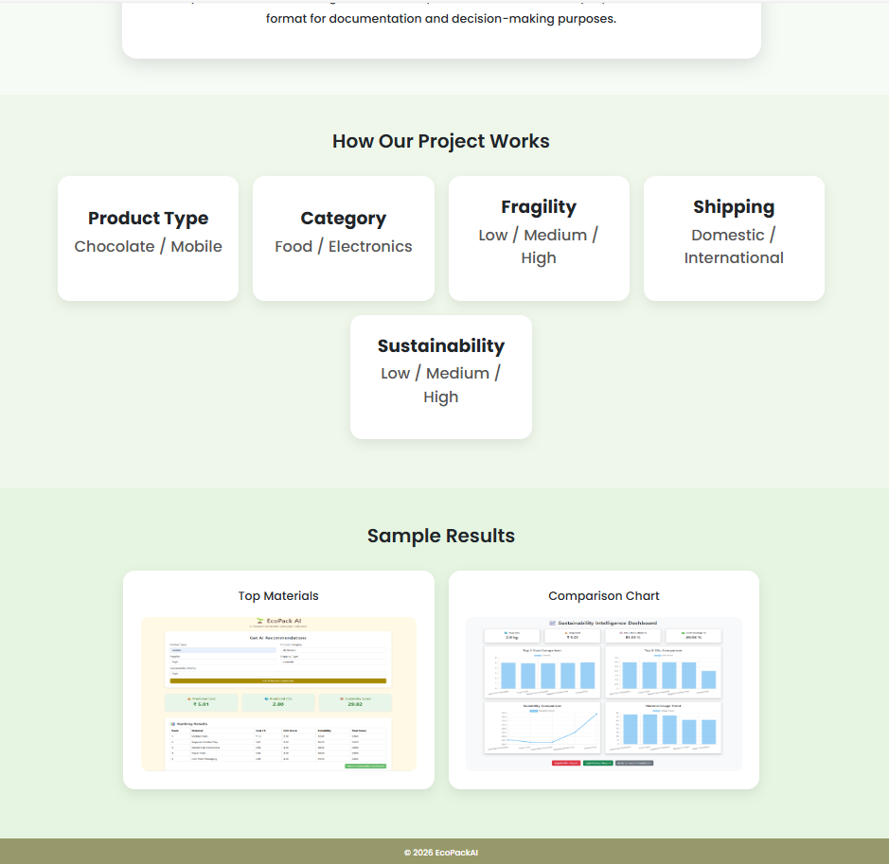
PROJECT DASHBOARD
STARTING PAGE

Slide 13
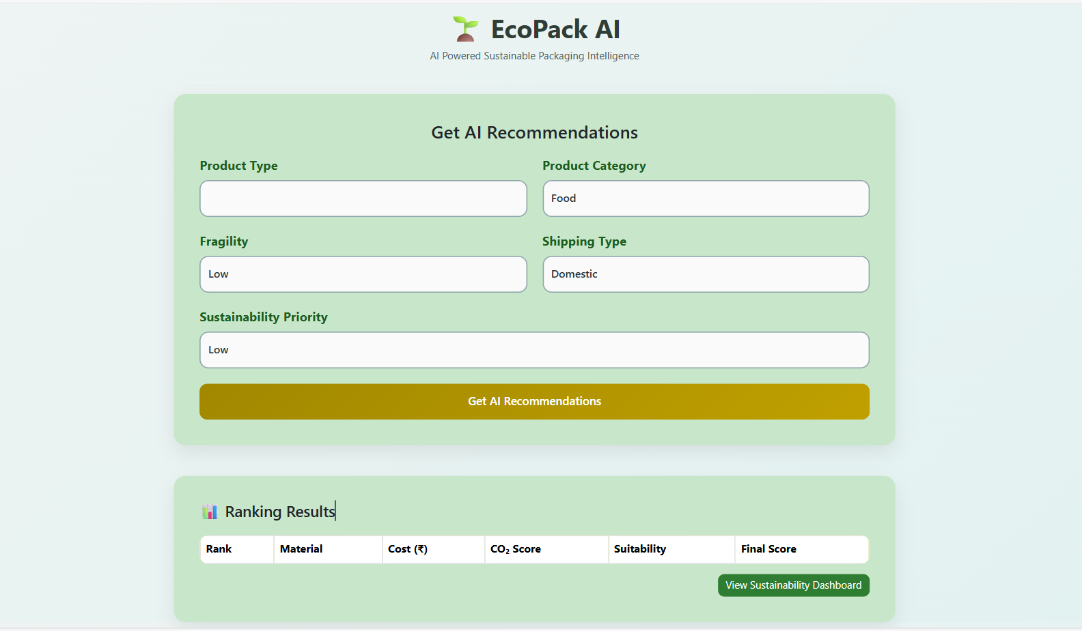
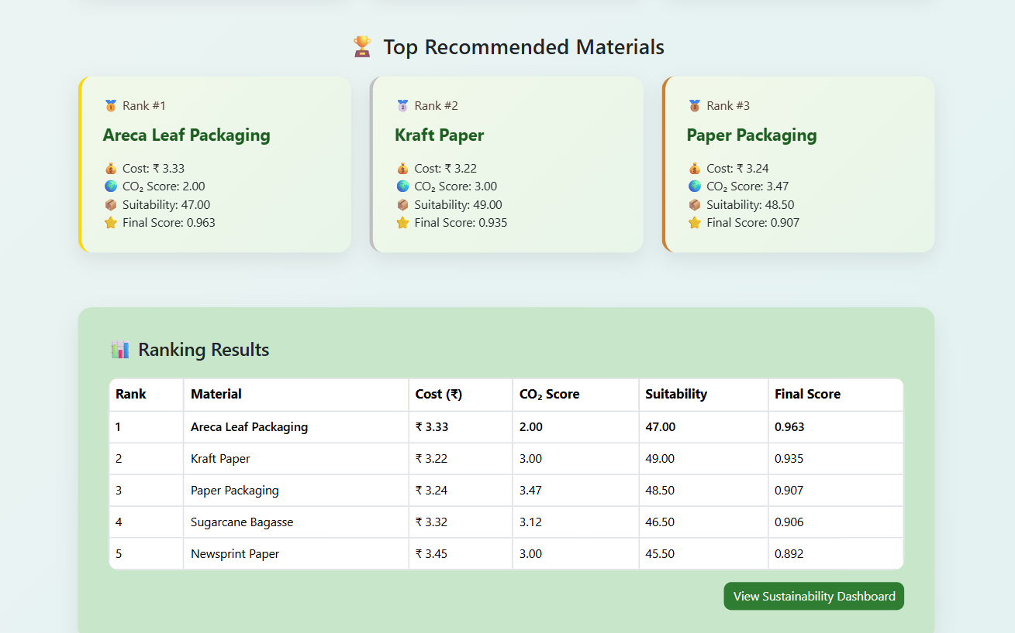
USER INPUTS DASHBOARD

Slide 14
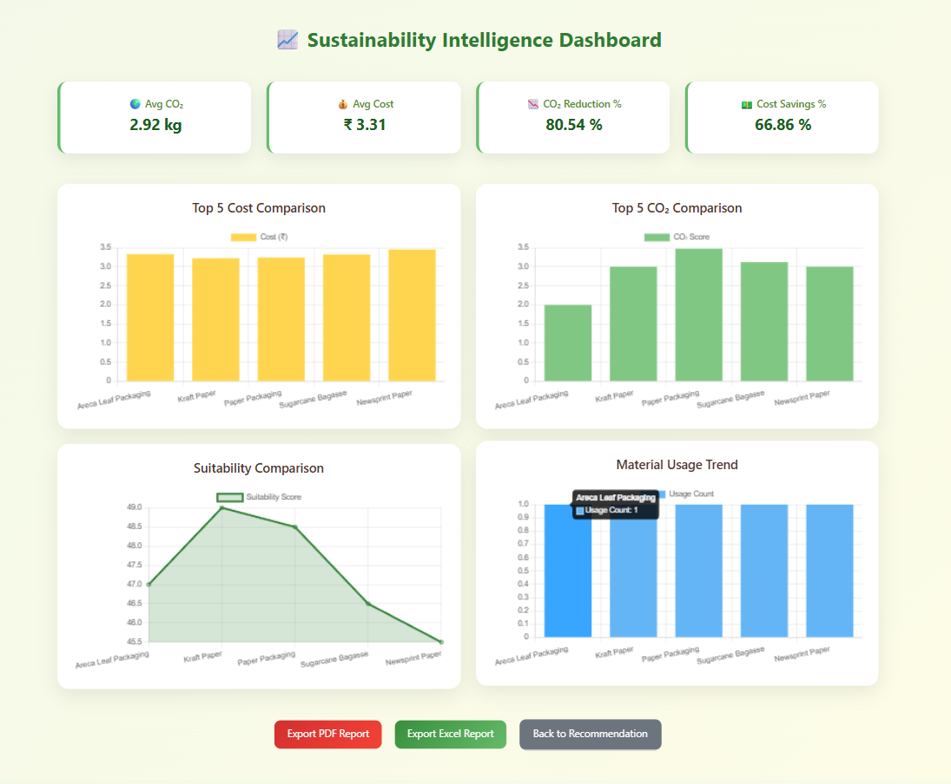
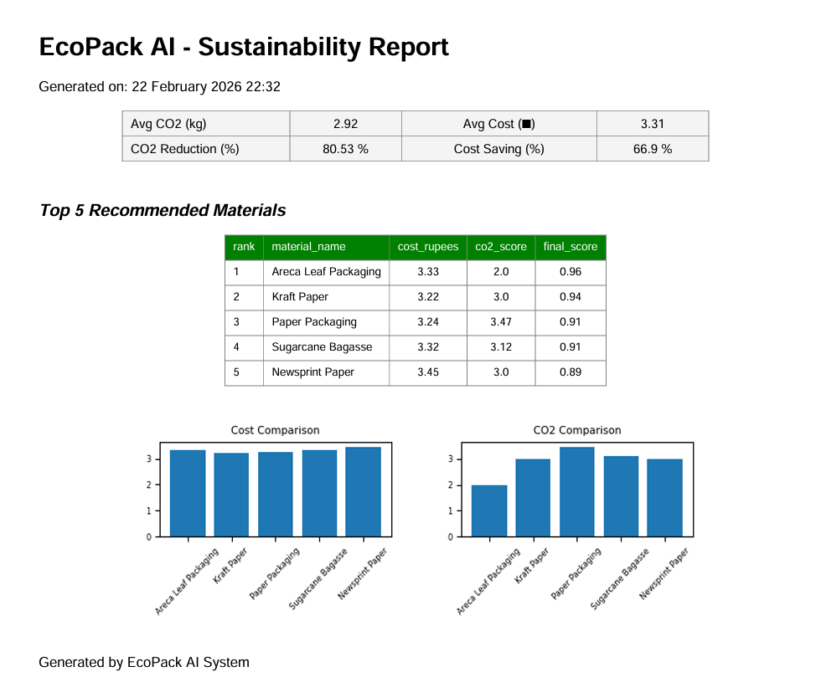
SUSTAINABILITY DASHBOARD
PDF REPORT

Slide 15
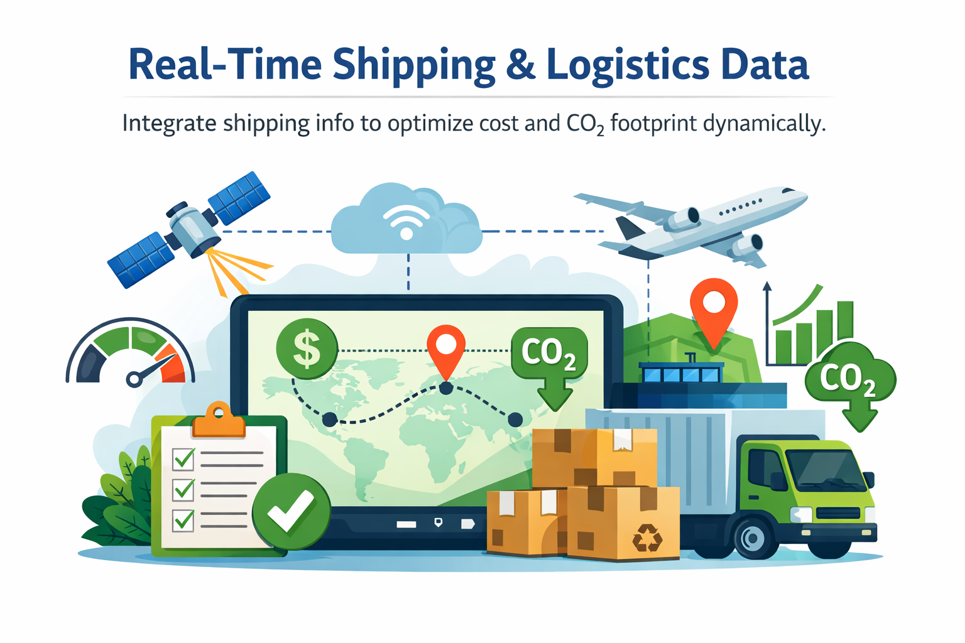

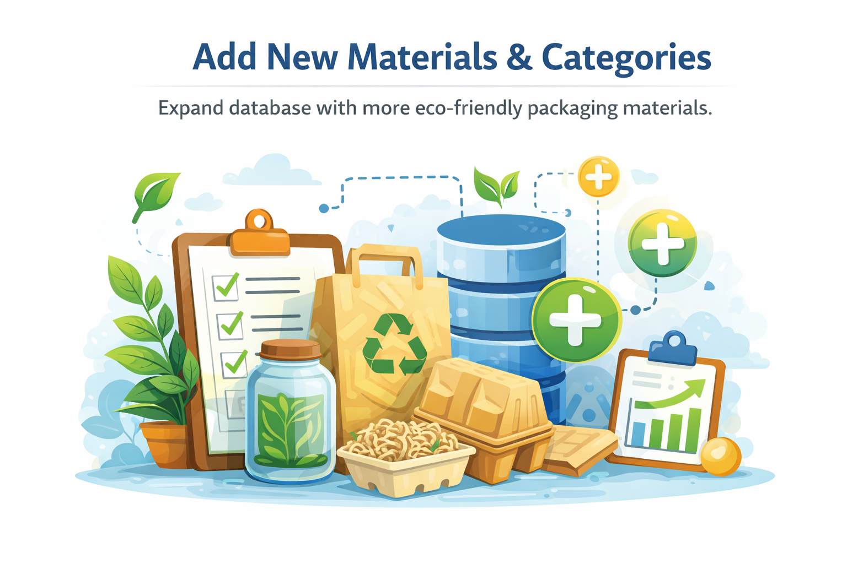
FUTURE SCOPE
Real-Time Shipping & Logistics Data
Integrate shipping info to optimize cost and CO₂ footprint dynamically.
Enhanced Dashboard Analytics
Add predictive insights and trend analysis for better decision-making.
Add New Materials & Categories
Expand database with more eco-friendly packaging materials.

Slide 16

THANK YOU

